Slide 1
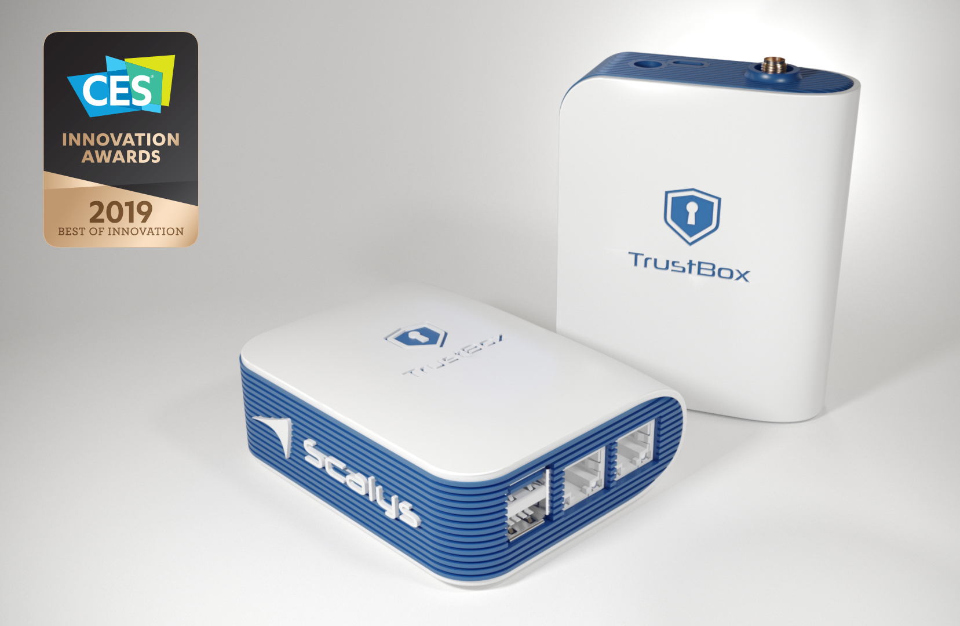



We secure the communication
Scalys offers a unique set of High-Grade Communication solutions and products for the consumer & Industrial market with a military grade of security (hardening).
Scalys creates enterprise-level routers, sensor-, (I)IoT)-gateways, communication hubs and secure edge devices combining leading technology with innovative design concepts to modernize and secure the communication of these connected devices.
Scalys can customize products to help companies and startups create their own solutions based on our platforms.
Scalys, based in Hengelo (the Netherlands), is founded in 2017.
Partners

Slide 2
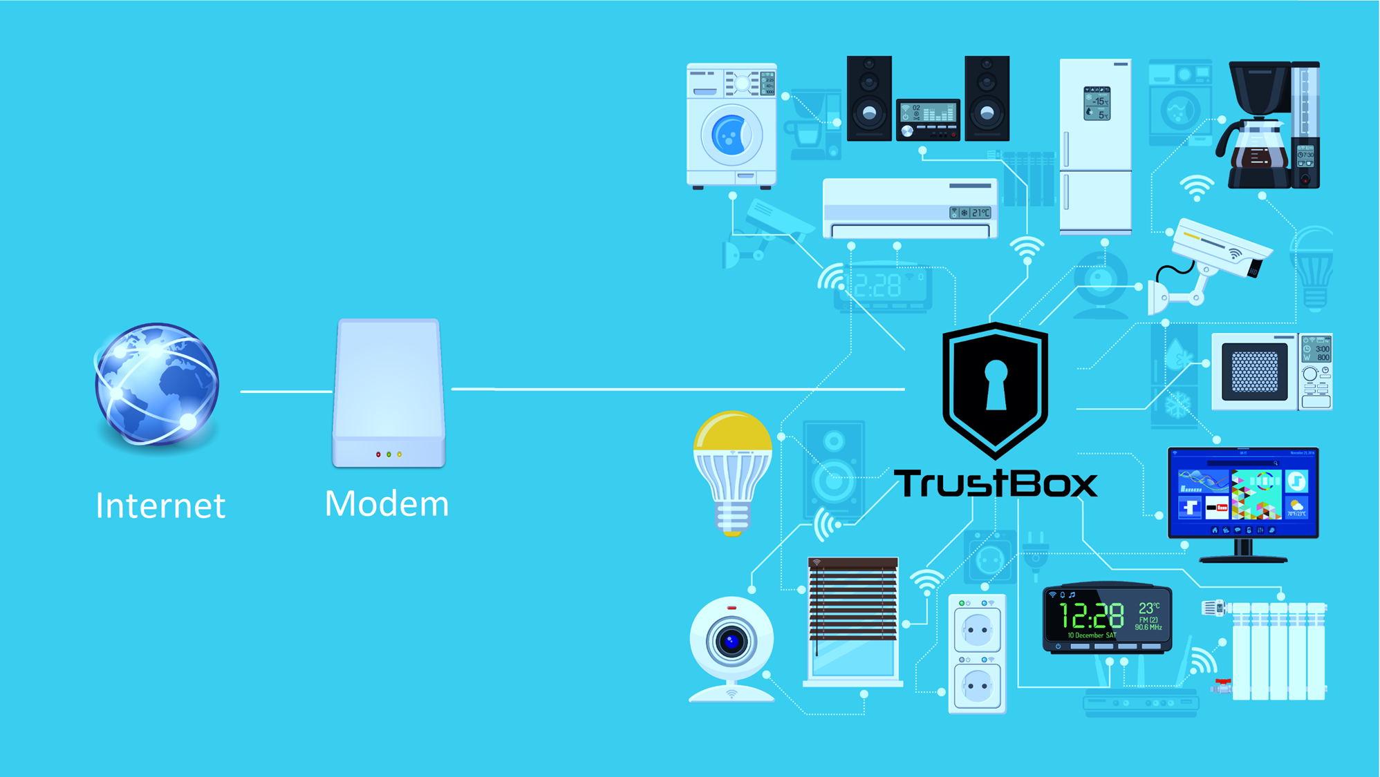

Your home network is at risk!
TrustBox router - cyber security protection
  Protection of firmware
    No MITM attack
  Secure Software updates
    Secure software provisioning
  Secure hardware hardened
  platform implemented
    ARM TrustZone, OP-TEE,
    integrated secure element
  Protection of user credentials
  Open source platform
  Threat monitoring and management with partners

Slide 3
TrustBox (Industrial)IoT Gateway
Worked together with Microsoft to enable “Open Enclave” software on our TrustBox
Open Enclave adds a security software layer to Azure IoT Edge
For ARM based devices,
Microsoft selected our TrustBox
Azure IoT Edge Device
Azure
IoT
Edge
IoT leaf devices
Secured OS
OS agnostic
Azure IoT Edge Security Manager
Microsoft
Tamper resistant hardware root of trust
Scalys TrustBox

Slide 4

Contact details

